Slide 1



HPN Dashboard
View in Power BI
Last data refresh:
2/15/2024 12:40:59 AM UTC
Downloaded at:
2/15/2024 12:43:59 AM UTC

Slide 2
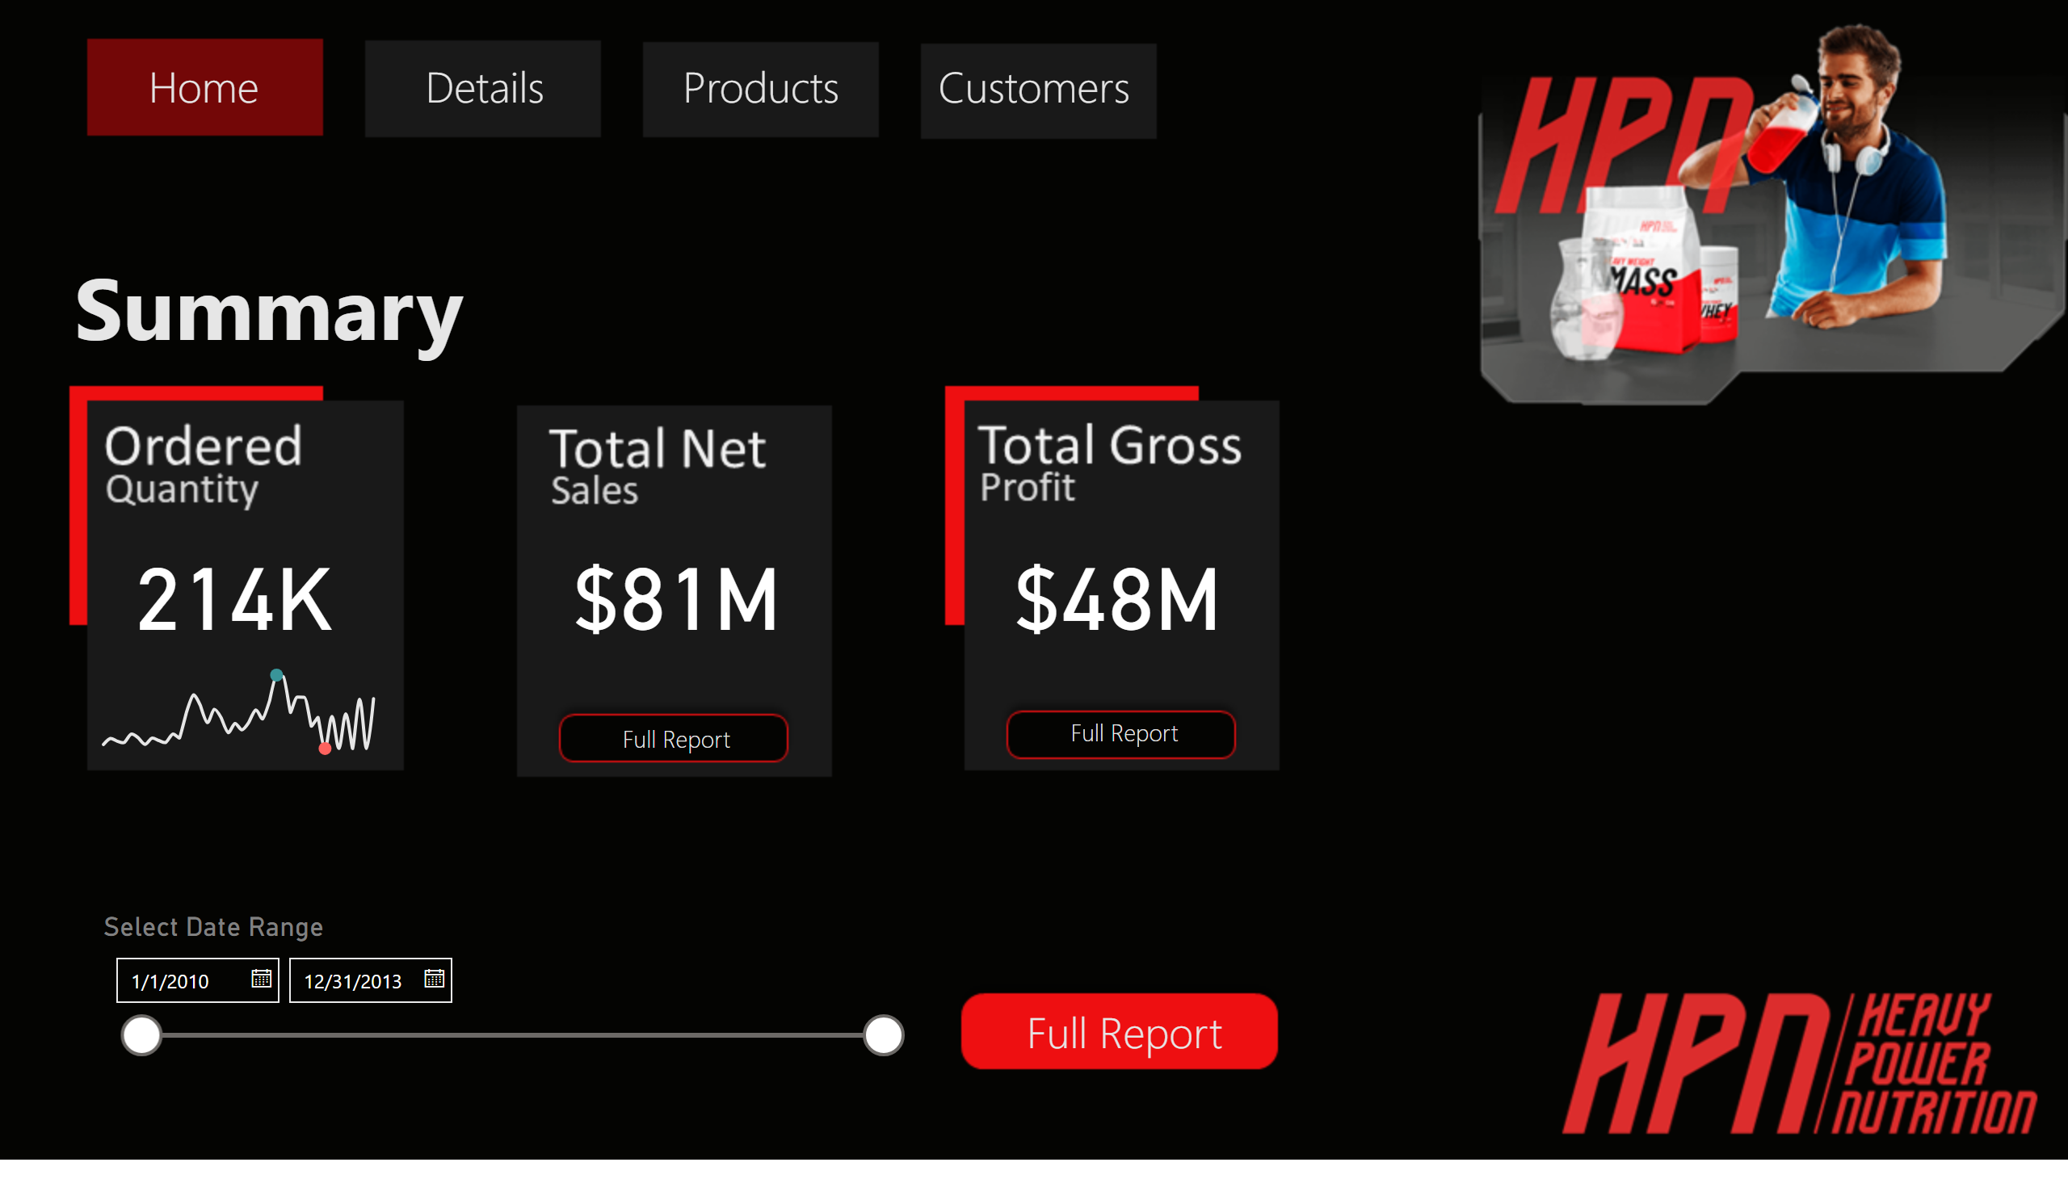
Home
Notes:
card
No alt text provided
card
No alt text provided
card
No alt text provided
actionButton
No alt text provided
actionButton
No alt text provided
actionButton
No alt text provided
PBI_CV_25997FEB_F466_44FA_B562_AC4063283C4C
No alt text provided
textbox
No alt text provided
actionButton
No alt text provided
Select Date Range
No alt text provided
actionButton
No alt text provided
actionButton
No alt text provided
actionButton
No alt text provided

Slide 3
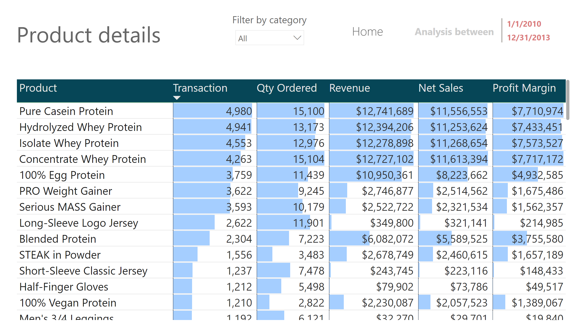
Products
Notes:
tableEx
No alt text provided
slicer
No alt text provided
slicer
No alt text provided
textbox
No alt text provided
multiRowCard
No alt text provided
slicer
No alt text provided
textbox
No alt text provided
textbox
No alt text provided
actionButton
No alt text provided

Slide 4
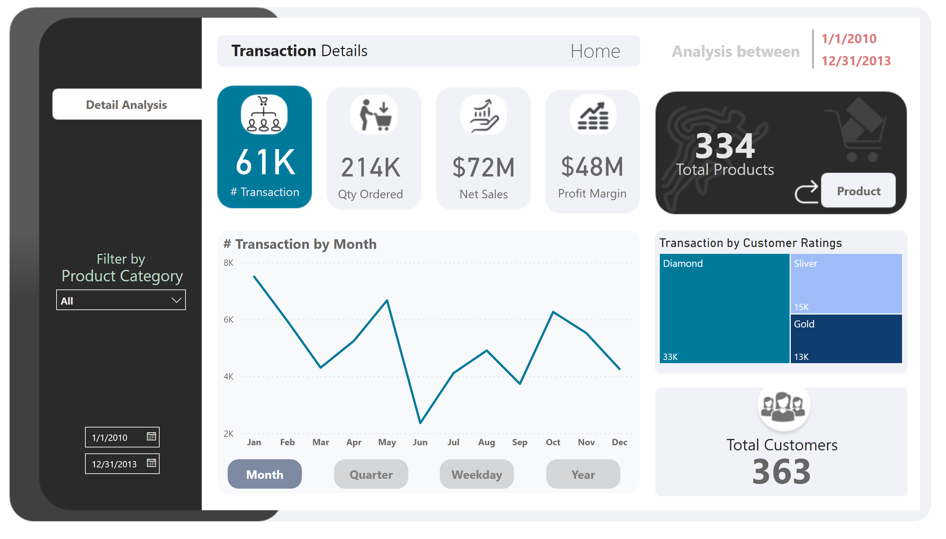
Transactions
Notes:
card
No alt text provided
card
No alt text provided
card
No alt text provided
card
No alt text provided
lineChart
No alt text provided
actionButton
No alt text provided
ActiveMonth
No alt text provided
actionButton
No alt text provided
InactiveQrt
No alt text provided
InactiveWeek
No alt text provided
actionButton
No alt text provided
InactiveYear
No alt text provided
actionButton
No alt text provided
columnChart
No alt text provided
columnChart
No alt text provided
columnChart
No alt text provided
textbox
No alt text provided
treemap
No alt text provided
textbox
No alt text provided
card
No alt text provided
actionButton
No alt text provided
actionButton
No alt text provided
textbox
No alt text provided
card
No alt text provided
actionButton
No alt text provided
slicer
No alt text provided
textbox
No alt text provided
textbox
No alt text provided
actionButton
No alt text provided
actionButton
No alt text provided
actionButton
No alt text provided
multiRowCard
No alt text provided
textbox
No alt text provided
Select Date Range
No alt text provided

Slide 5
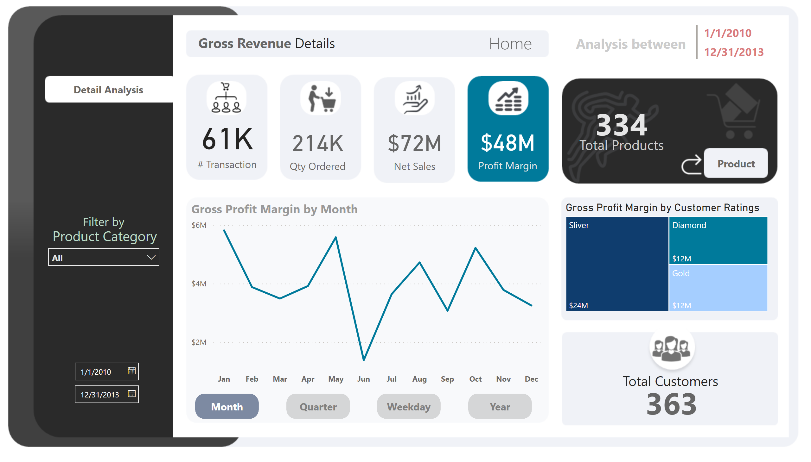
Profits
Notes:
card
No alt text provided
card
No alt text provided
card
No alt text provided
card
No alt text provided
lineChart
No alt text provided
actionButton
No alt text provided
ActiveMonth
No alt text provided
actionButton
No alt text provided
InactiveQrt
No alt text provided
InactiveWeek
No alt text provided
actionButton
No alt text provided
InactiveYear
No alt text provided
actionButton
No alt text provided
columnChart
No alt text provided
columnChart
No alt text provided
columnChart
No alt text provided
textbox
No alt text provided
treemap
No alt text provided
textbox
No alt text provided
card
No alt text provided
actionButton
No alt text provided
actionButton
No alt text provided
textbox
No alt text provided
card
No alt text provided
actionButton
No alt text provided
actionButton
No alt text provided
actionButton
No alt text provided
actionButton
No alt text provided
multiRowCard
No alt text provided
textbox
No alt text provided
Select Date Range
No alt text provided
slicer
No alt text provided
textbox
No alt text provided
textbox
No alt text provided

Slide 6
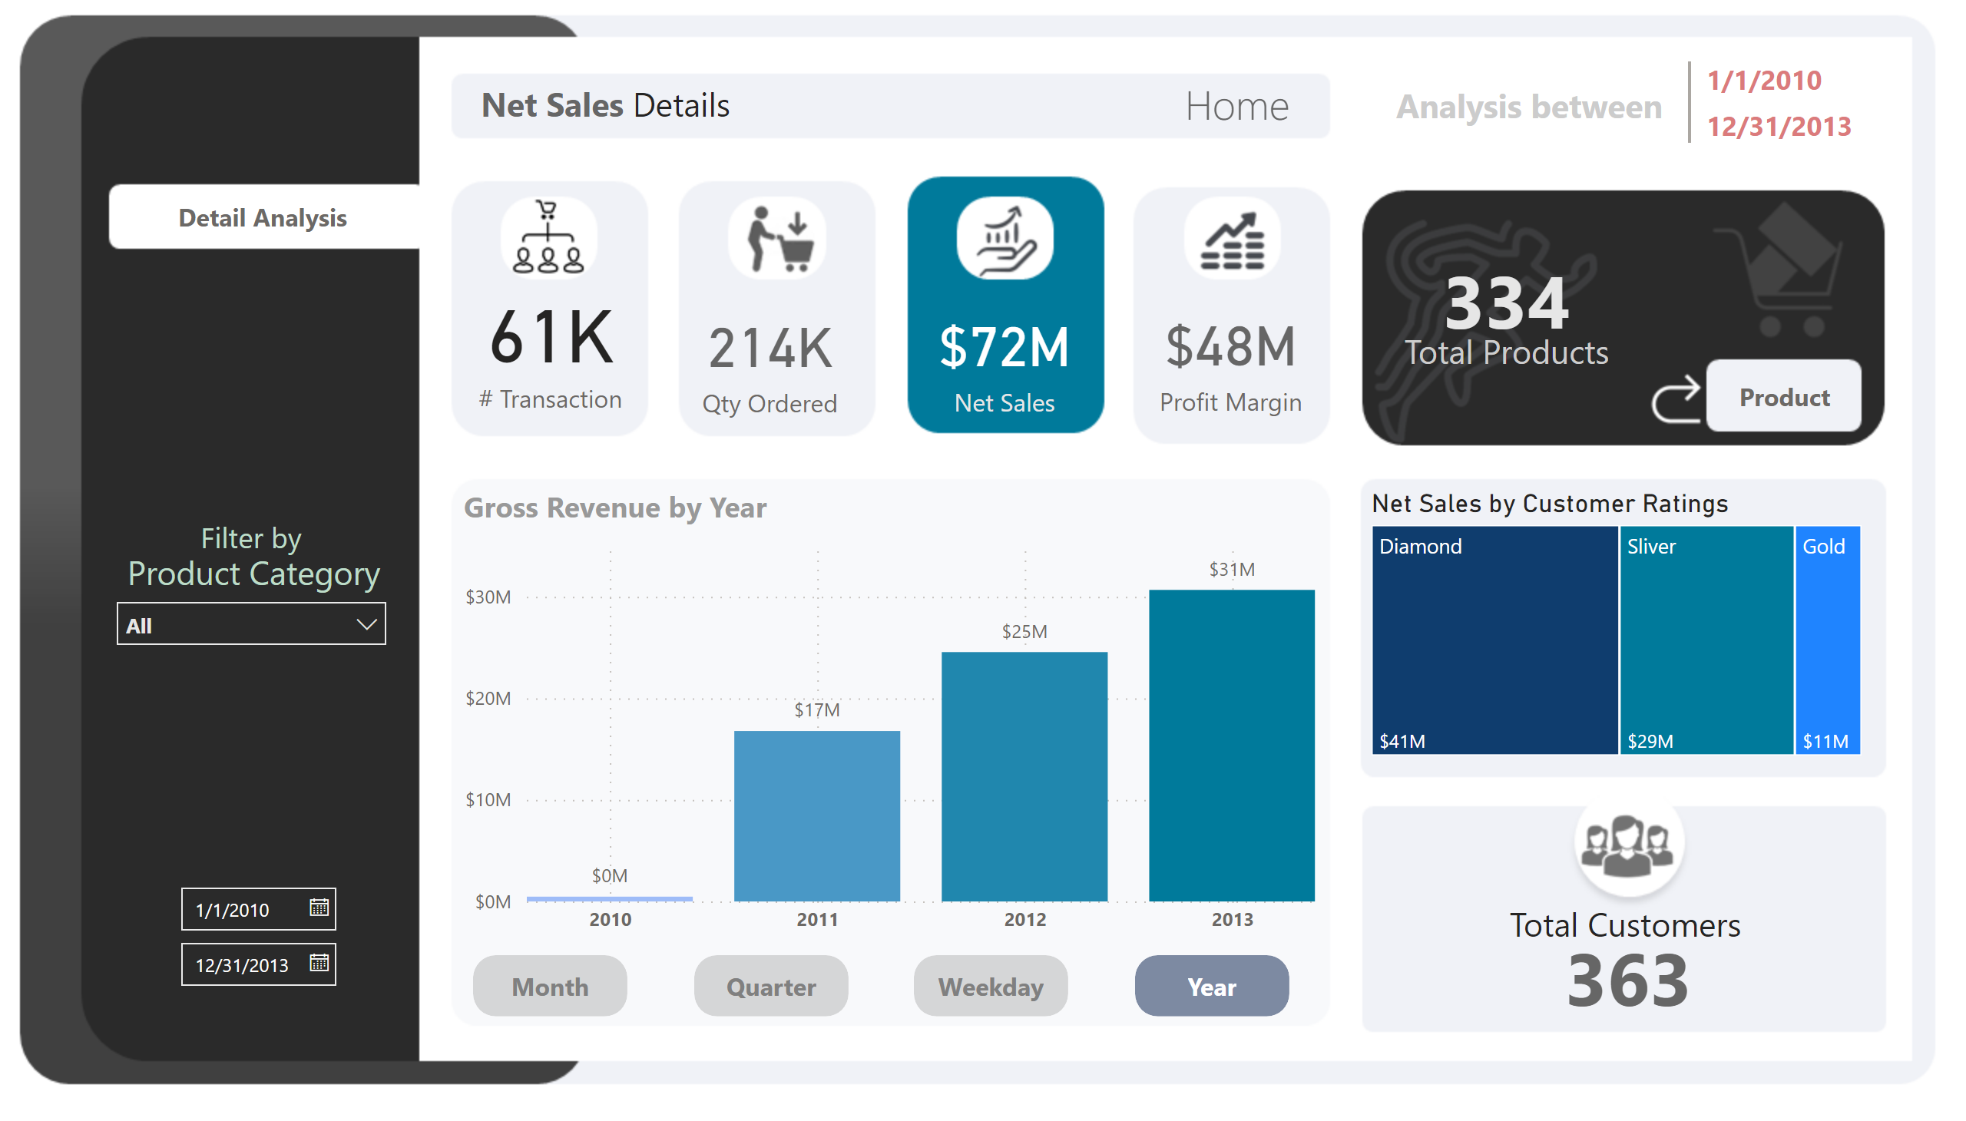
Revenue
Notes:
card
No alt text provided
card
No alt text provided
card
No alt text provided
card
No alt text provided
lineChart
No alt text provided
InactiveMonth
No alt text provided
actionButton
No alt text provided
actionButton
No alt text provided
InactiveQrt
No alt text provided
InactiveWeek
No alt text provided
actionButton
No alt text provided
actionButton
No alt text provided
ActiveYear
No alt text provided
columnChart
No alt text provided
columnChart
No alt text provided
Gross Revenue by Year
No alt text provided
textbox
No alt text provided
Net Sales by Customer Ratings
No alt text provided
textbox
No alt text provided
card
No alt text provided
actionButton
No alt text provided
actionButton
No alt text provided
textbox
No alt text provided
card
No alt text provided
actionButton
No alt text provided
actionButton
No alt text provided
actionButton
No alt text provided
actionButton
No alt text provided
multiRowCard
No alt text provided
textbox
No alt text provided
Select Date Range
No alt text provided
slicer
No alt text provided
textbox
No alt text provided
textbox
No alt text provided

Slide 7
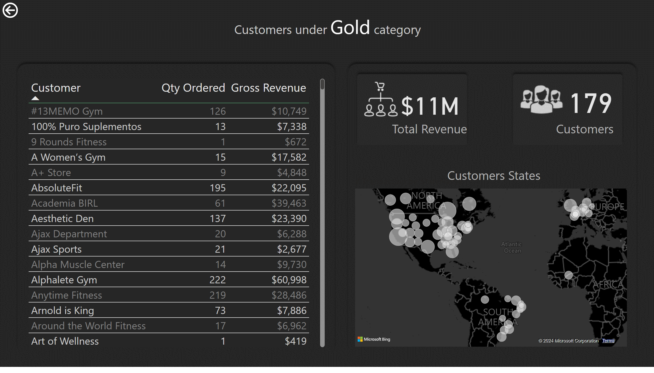
Gold Customers
Notes:
tableEx
No alt text provided
map
No alt text provided
card
No alt text provided
card
No alt text provided
textbox
No alt text provided
textbox
No alt text provided
textbox
No alt text provided
textbox
No alt text provided
actionButton
No alt text provided
slicer
No alt text provided
slicer
No alt text provided

Slide 8
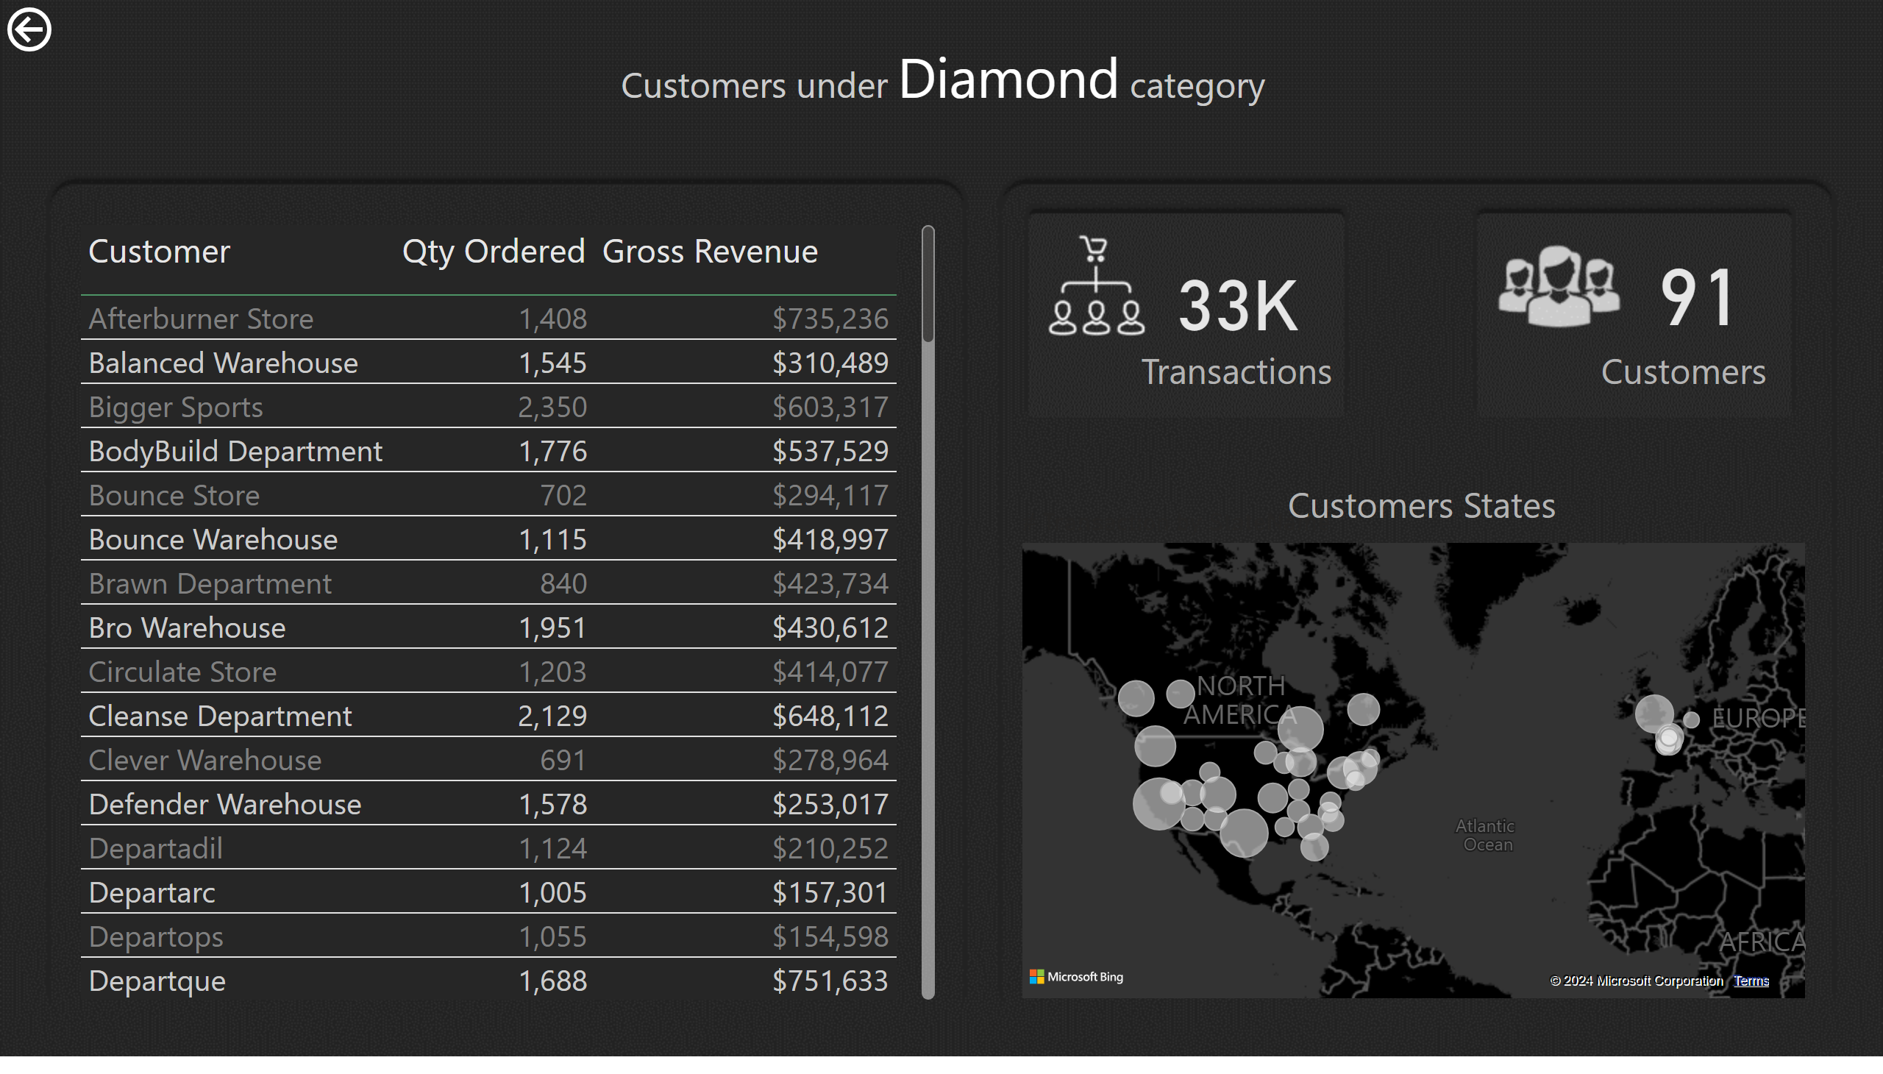
Diamond Customers
Notes:
tableEx
No alt text provided
actionButton
No alt text provided
map
No alt text provided
card
No alt text provided
card
No alt text provided
textbox
No alt text provided
textbox
No alt text provided
textbox
No alt text provided
textbox
No alt text provided
slicer
No alt text provided
slicer
No alt text provided

